Slide 1
Addressing School Psychologist Shortages Through Advocacy and Strategic Communication
Nate von der Embse, Ph.D., NCSP
Associate Professor of School Psychology
University of South Florida

Slide 2
How to Participate in Today’s Discussion
Text NATEV338 to 37607
Or go to pollev.com/natev338

Slide 3
Notes:
Do not modify the notes in this section to avoid tampering with the Poll Everywhere activity. More info at polleverywhere.com/support What do you hope to learn from today's discussion?
https://www.polleverywhere.com/free_text_polls/LNwK557TDFoNl7wz3Q8Mm

Slide 4
Learning Outcomes
What:
Understanding School Psychologist Shortages in GA and US
Identifying Contributing Factors to Shortages
So What:
Linking Shortages to Student and School Outcomes
What Now:
Developing Key Messages to Decision-Makers

Slide 5
Making The Case for School Psychologists

Slide 6
School Psychologist Shortages

Slide 8
Notes:
Do not modify the notes in this section to avoid tampering with the Poll Everywhere activity. More info at polleverywhere.com/support What is the school psychologist to student ratio at your school?
https://www.polleverywhere.com/multiple_choice_polls/lvWZc6MJiguEqUmJUSM7T?flow=Default&onscreen=persist

Slide 9
A Multi-Dimensional Shortage
There is a critical shortage in both practitioners and in the availability of graduate education programs and faculty needed to train the workforce necessary to keep up with the growing student population.
Insufficient supply of qualified school psychologists and school psychologists from diverse backgrounds, graduate faculty, and qualified practica and internship supervisors
Insufficient number of positions within districts to expand role

Slide 10
Practitioner Shortage
Georgia
1.7 million public school students
800 school psychologists
1 to 2283 ratio
Florida
2.8 million public school students
1 to 1860 ratio
Ohio
1.7 million public school students
1 to 800 ratio

Slide 11
Georgia Trends
A GASP survey indicated that over 30% of the current workforce are eligible for retirement within 3 years suggesting an impending school psychologist workforce shortage.
If double the current number of SPs, ratio would be 1 to 1000

Slide 12
Training Shortage
Three NASP approved training programs in GA
University of Georgia (Doc)—average of 4 graduates
Georgia State University (Doc, EdS)—average of 8-10 graduates
Georgia Southern University (Specialist)--??
7 Training Programs in FL—approximately 60 grads
9 Training Programs in OH—approximately 90 grads

Slide 13
Notes:
Do not modify the notes in this section to avoid tampering with the Poll Everywhere activity. More info at polleverywhere.com/support What is the impact of a school psychologist shortage on your role and function?
https://www.polleverywhere.com/free_text_polls/Z7b6VNzzU3CDTSpKflM6k

Slide 14
Impacts of Shortages
Undermine the availability of high-quality services to students, families, and schools.
Unmanageable caseloads
Inability to provide prevention and early intervention services
Reduced access to mental and behavioral health services
Limited scope of service delivery focused primarily on legally mandated special education practice.

Slide 15
5 Steps to Clarifying Your Message
Identify the pressing issues and relevant key stakeholders
Identify existing and needed resources
Draft your messages
Consider how they will work together for different issues
Create brief resources conveying your messages and data

Slide 16
1. Identify Pressing Issues in Your State

Slide 17
Assess the Situation
How do issues align/conflict with your goals?
How do current policies and practices in your district/state reinforce or undermine your position?
Get input from members

Slide 18
Assess the Situation
Who are your key stakeholders? Where/ whom do you need to focus your efforts?
Universities, legislators, federal/state agencies, state local school boards?
Examine existing legislation/policy that can help or hinder your mission.
Do you need to introduce legislation?
Is there legislation you need to fight?

Slide 19
Nationwide Priorities
School Safety & Crisis Response
Mental Health Access
Practitioner Shortages
Suicide Prevention

Slide 20
Be Specific
Calls for changes related to issues such as practitioner shortages, mandated threat assessment teams, active shooter drills, bullying prevention, increased access to mental health services, etc.
For example:
Is there a lack of access to school mental health services?
Is there a trend back toward zero tolerance for fear of violence?
Is disproportional discipline a focus?
Suicide prevention?
Trauma sensitive schools?
Opioid crisis?

Slide 21
Gather Member Feedback
Ask 2 simple questions
What are the 2 most serious/pressing problems in schools that are exacerbated by shortages?
What are the most serious consequences to students?
Give people options to choose for each question rather than open-ended.
Do this at fall conferences (flip chart post-it paper)
Or use Survey Monkey
Or a quick poll (http://directpoll.com/)

Slide 22
2. Identify Existing/Needed Resources and Materials
Notes:
KC

Slide 23
Resources Inventory
Existing
Locate
Adapt
Develop
☑
☑
Key talking points
Research Reports
Fact sheets
Position papers
Policy recs
Infographs
Op-eds
☑
☑
☑
☑
☑
☑
☑
☑

Slide 24
Notes:
Do not modify the notes in this section to avoid tampering with the Poll Everywhere activity. More info at polleverywhere.com/support What resources do you have to support your key message?
https://www.polleverywhere.com/multiple_choice_polls/7PZsRraZCuxzLxftBHvBZ?flow=Default&onscreen=persist

Slide 25
3. Draft Your Messages
Notes:
KC

Slide 26
School Psychologists as Mental Health Providers???

Slide 27
Effective Message Structure
Benefit
Problem statement
Action/solution
Benefits
Easy for People to Grasp
Action
Problem
27
Notes:
27

Slide 28
Message Development Worksheet
Notes:
KC

Slide 29
4. Consider how they will fit together for different issues

Slide 30
Complete Message Example: Mental Health
Problem: Student mental health problems are a growing concern.
Student behavior and learning are being impacted by stress, anxiety, and depression.
Youth suicide rates have risen dramatically in the last decade (CDC, 2018).
Action/Solution(s): Increasing access to school mental health services enables schools to provide prevention and early intervention services.
Universal screenings enable us to identify students struggling with a mental health problem before they reach a crisis.
Improving our ratio of school psychologists to students gives students more reliable access to counseling and referral services.
School-employed mental health professionals can provide mental health first aid training to school staff.
Benefit: School staff will be better prepared to recognize and support at-risk students, provide more effective behavioral interventions, and reduce the negative consequences of mental health problems.
Notes:
The direct relationship between problem, action, benefit is critical to comprehension. You want to adjust messages to the audience.
Students (academic scores, behavior data, attendance, referrals).
Staff (morale, skills, collaboration, classroom climate, professional development).
Parents (involvement, collaboration, communication).
Administration (AYP, school climate, resource allocation, legal requirements, district agendas, academic priorities).
Community (access to services, collaboration, involvement, safety).
(Tip: Ground problem in assessment/data.)

Slide 31
Complete Message Example: Safety
Problem: Schools are increasingly relying on physical security measures like metal detectors and armed security.
Overly restrictive measures make students feel less safe.
Action/Solution: Balancing physical and psychological safety is critical to supporting student well-being and the overall learning environment.
Efforts to prevent violence must align with efforts to improve school climate, overall safety, and learning.
Trained multidisciplinary school safety and crisis teams can regularly assess safety needs and response/recovery readiness
School psychologists can help develop, implement and evaluate policies and practices that promote safe school environments for all students
Benefit: Students who feel both physically and psychologically safe are more able to engage in learning and positive relationships.

Slide 34
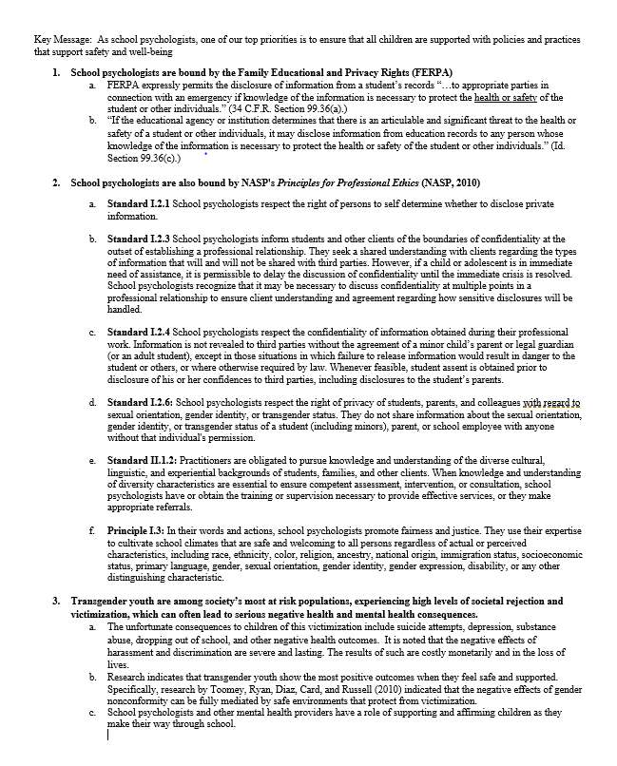
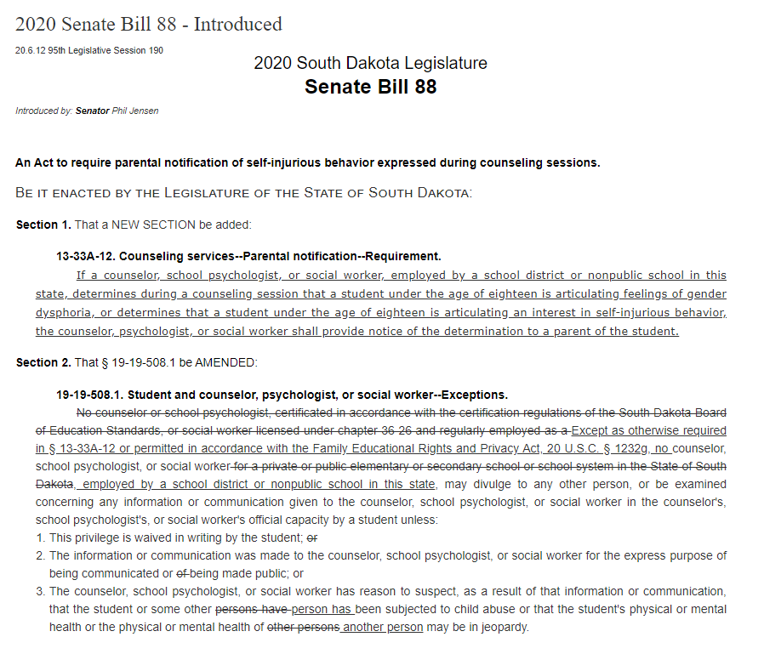
Notes:
KC

Slide 35
5. Create Resources Conveying Your Key Messages and Data
Notes:
KC

Slide 36
Two Page Fact Sheet
2-4 page fact sheet
Brief overview statement (2-3 sentences)
Brief/bulleted fact statements
Pullout 2-4 key points to highlight visually (e.g., in a text box)
Brief statement about association
Contact info and website
Length depends on use or references and pullouts/graphics
Notes:
KC

Slide 37
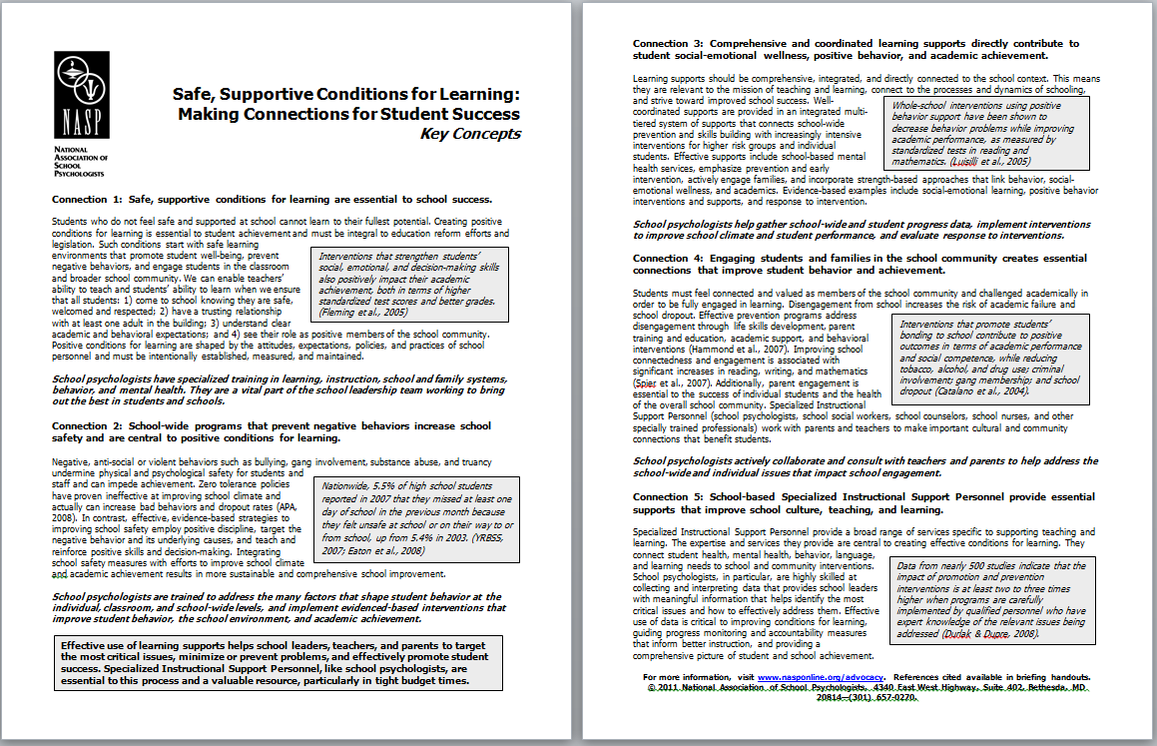
Notes:
KC

Slide 38
Notes:
KC

Slide 39
Infographics
Online platforms
www.canva.com
www.Piktochart.com
PowerPoint
https://www.hubspot.com/infographic-templates
5-8 points (depending on size)
Use icons, pictures, pie charts, bar graphs
Icons at https://thenounproject.com/
Include key message at the top
Include supporting message at the bottom
Include association info/website
Notes:
KC

Slide 41
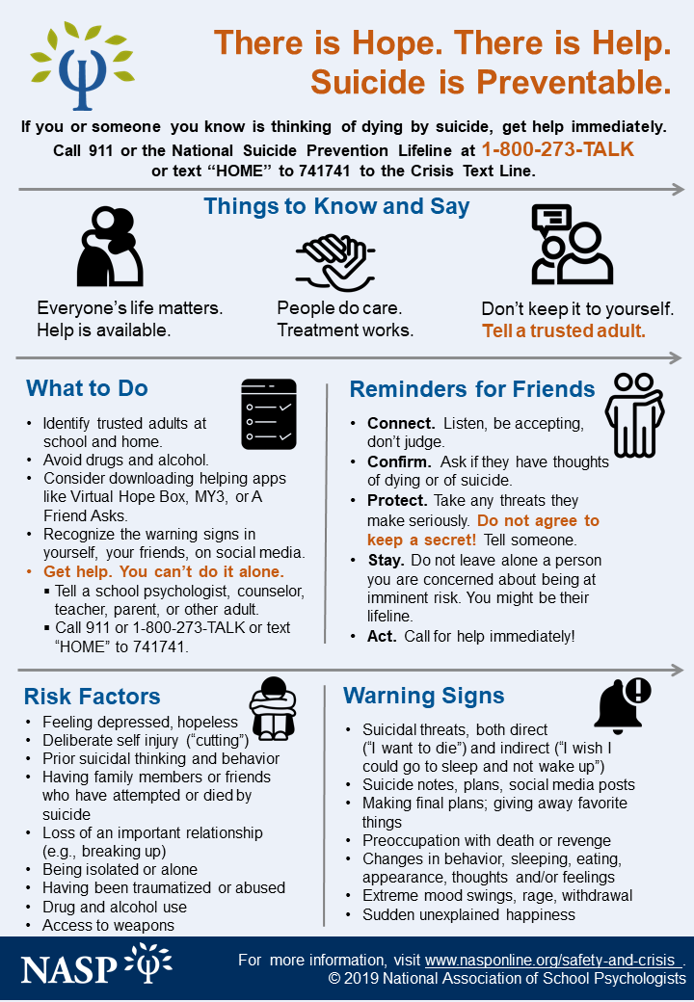
Other Formats
Notes:
Process for connecting with critical stakeholders
AA: In Texas, constantly battling with psychologists. During one hearing on our title issue, our sponsoring legislator got confused and then easily swayed by legislators that were supporting the psychologists and thus she withdrew her bill from consideration. Later in talking to her staff, she had our talking points sheet, but would an even briefer graphic been more impactful/easy to see/spot at a moment’s notice??

Slide 42
What Now?
Key message: The shortage of school psychologists is making it difficult to meet student needs.
Key message: Effective school safety measures require adequate access to school psychologists and other school-employed mental health professionals.
Key message: Improving the ratio will help schools meet the comprehensive mental and behavioral health needs of students (See Mental and Behavioral Health Key Messages)
Key message: Communities rely on schools to meet the needs of all students as schools are where students spend a significant amount of time.

Slide 43
Notes:
Do not modify the notes in this section to avoid tampering with the Poll Everywhere activity. More info at polleverywhere.com/support What do we need to increase the number of school psychologists in Georgia?
https://www.polleverywhere.com/free_text_polls/aUJb26SAw7XFGzfbcpsEK

Slide 44
What We Need
Consistent data collection of the number of FTE school psychologists employed at the district and state level to allow for targeted efforts to reduce the ratio in areas of greatest need.
Sustained efforts toward reducing the ratio of students to school psychologists and other school employed mental health professionals
Effective utilization of school psychologists in the school setting to include reallocation of existing school psychologists’ time (e.g., reduce paperwork) so that they are able to provide a broad range of school psychological services to all students.
Improved coordination with local universities to offer high quality practicum and internship sites.

Slide 45
What We Need
Maintaining a competitive salary and benefit package (including a stipend for the NCSP credential) to help recruit and retain high quality school psychologists.
Increase federal, state, and local funding streams to hire fully certified and/or licensed school psychologists, especially in high need and hard to staff districts.
Implement or expand grant or loan forgiveness opportunities to increase the number of students

Slide 46
What We Need
Create pathways to grant credentialing reciprocity for school psychologists across state lines
Nationally Certified School Psychologist certificate, to help remedy the shortages in rural and other underserved areas.
Restrict, minimize, or limit alternate or emergency credentialing that allows related professionals to supplant school psychologists when providing school psychological services.

Slide 47
Action Item for TODAY!
Identify an issue in your state that school psychologists can help address.
Review sample key messages handout.
Select relevant messages that make your case (3-5 max).
Adapt them to fit your context to the extent possible.
Using Action Plan, begin to identify stakeholders, action steps and needed resources.
Take ideas back to your state leadership to begin developing real messages, resources and plan.

Slide 48
Contact Information
Nate von der Embse
natev@usf.edu
Access Presentation Materials and Handouts
INSERT LINK
https://www.nasponline.org/resources-and-publications/resources-and-podcasts/school-psychology/shortages-in-school-psychology-resource-guide
https://www.nasponline.org/research-and-policy/policy-priorities/critical-policy-issues/shortage-of-school-psychologists
School Mental Health Collaboratives
www.smhcollaborative.org

Slide 49
Notes:
Do not modify the notes in this section to avoid tampering with the Poll Everywhere activity. More info at polleverywhere.com/support This presentation was:
https://www.polleverywhere.com/multiple_choice_polls/Ldq1y6aigm8TxWq?flow=Default&onscreen=persist

Slide 50
Reflection Questions
Who are 1 or 2 individuals that you can contact today about school psychologist shortages?
What are 1 or 2 new ideas that excite you remedying shortages?
Identify 1 or 2 steps that you would like to take to increase the number of school psychologists in Georgia.

